Slide 1
Automatic Net Connectivity in Linux

Slide 2
Some important commands for internet connectivity
#redhat-config-network //to open network configuration manager
ifconfig // to get information about active network
ping //used to test the reachability of a host

Slide 3
Methods to connect Internet
There are two ways to connect internet:
Automatic/Dynamic
Static

Slide 4
Steps to connect Internet Automatically

Slide 5
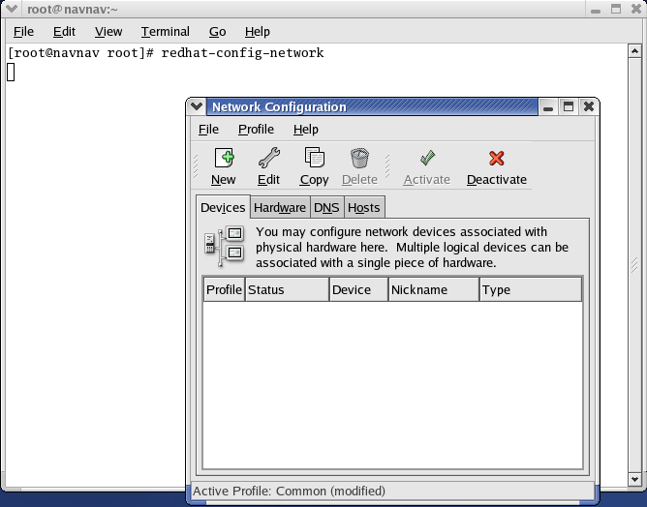
Go to terminal and type redhat-config-network
In network configuration manager, Select new

Slide 6
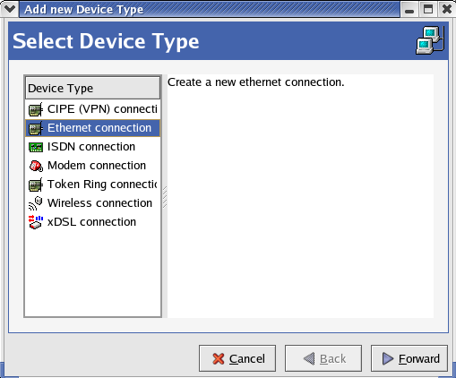
Select Ethernet connection and click on Forward.

Slide 7
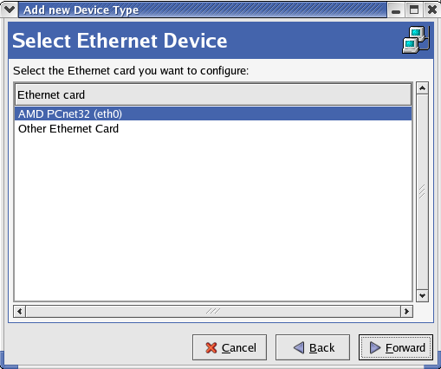
Select AMD PCnet32 (eth0) and click on Forward

Slide 8
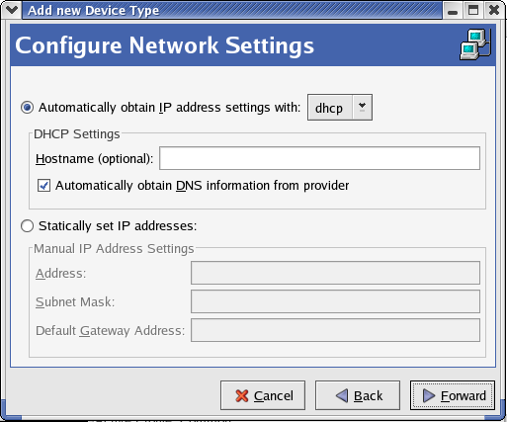
Select Automatically obtain IP address. Also tick automatically obtain DNS information from provider and click on Forward.

Slide 9
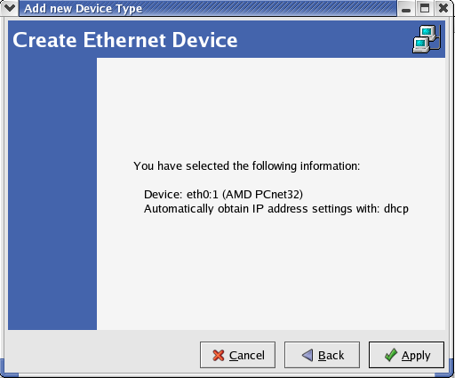
Click on apply

Slide 10
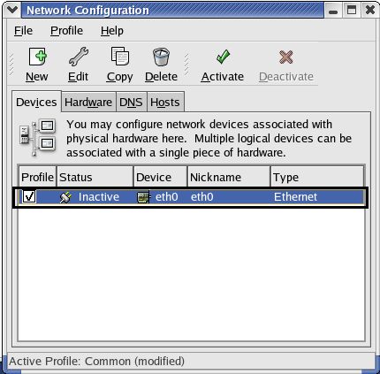
Now doubleclick on the blue link which is highligted here.

Slide 11
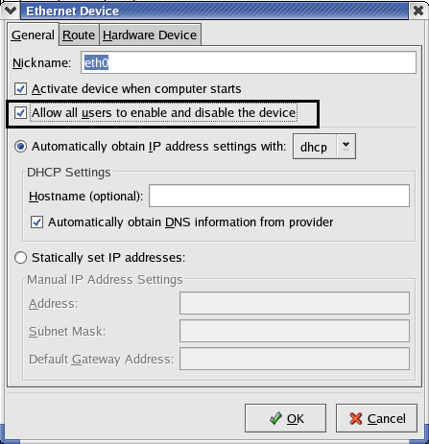
Check allow allusers to enable and disable the device and click on OK.

Slide 12
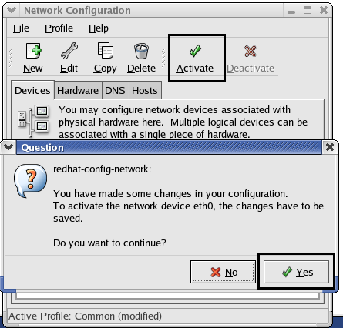
Now click on Activate option and then selece Yes option. After that click on Ok when changes saved message box appears. Nowyou will see one more message box which will give some error information regarding connection failed. Click on Ok. (This error message is because internet connection has been bounced by Vmware. To resolve this you have to make some changes to three files mentioned in next slides.) Close network configuration manager and go to terminal to make changes to files.

Slide 13
Path of the three files in which changes are to be done one by one
First file
#gedit /etc/sysconfig/network-scripts/ifcfg-eth0
Second file
#gedit /etc/sysconfig/networking/devices/ifcfg-eth0
Third file
#gedit /etc/sysconfig/networking/profiles/default/ifcfg-eth0
In all the paths after eth, its zero not O.

Slide 14
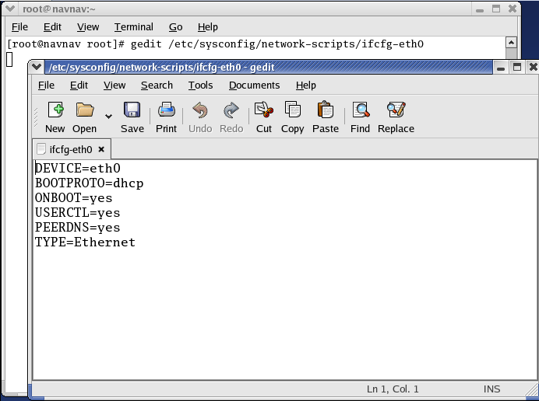
Go to terminal and type the path of the first file i.e.
#gedit /etc/sysconfig/network-scripts/ifcfg-eth0 and press enter.
File is opened and here check_link_down function is to be added as mentioned in next slide.

Slide 15
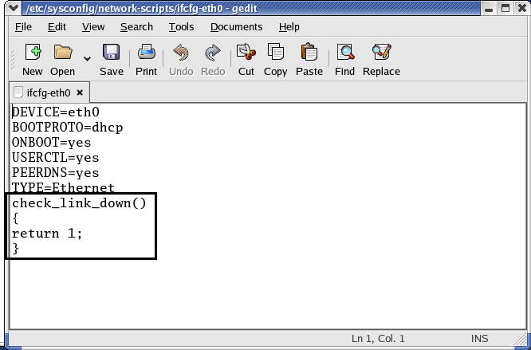
Add check_link_down function as highlighted above and don’t make any changes to the already written code. Now click on saveand close the file.
After this again go to terminal and type the path of second fileto make the same changes.

Slide 16
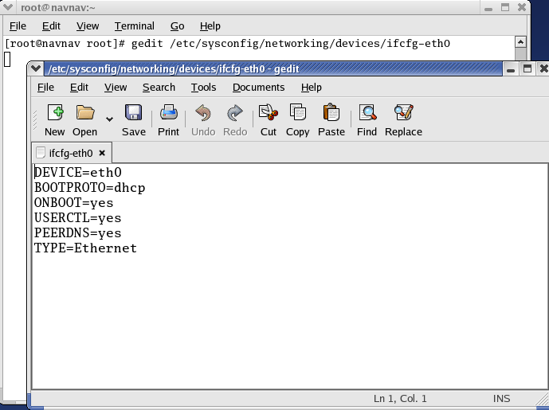
Type the path of the second file i.e.
#gedit /etc/sysconfig/networking/devices/ifcfg-eth0 and press enter.
File is opened and here check_link_down function is to be added as mentioned in next slide.

Slide 17
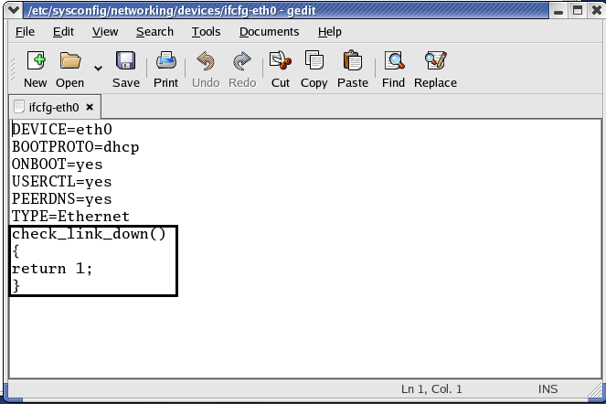
Add check_link_down function as highlighted above and don’t make any changes to the already written code. Now click on saveand close the file.
After this again go to terminal and type the path of third fileto make the same changes.

Slide 18
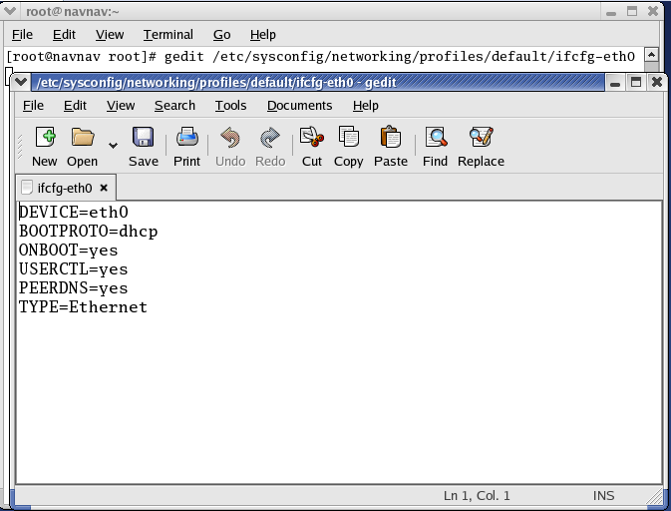
Type the path of the third file i.e.
#gedit /etc/sysconfig/networking/profiles/default/ifcfg-eth0 and press enter.
File is opened and here check_link_down function is to be added as mentioned in next slide.

Slide 19
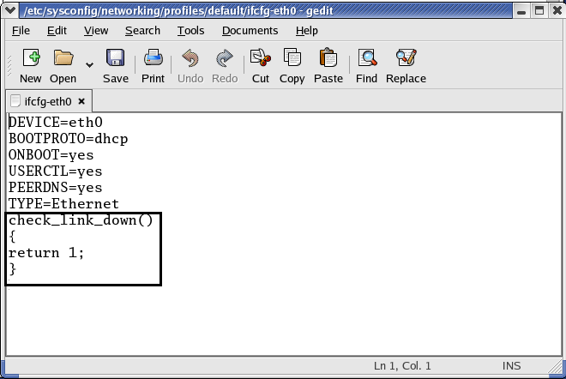
Add check_link_down function as highlighted above and don’t make any changes to the already written code. Now click on save and close the file. Go to terminal and type redhat-config-network to open network configuration manager.

Slide 20
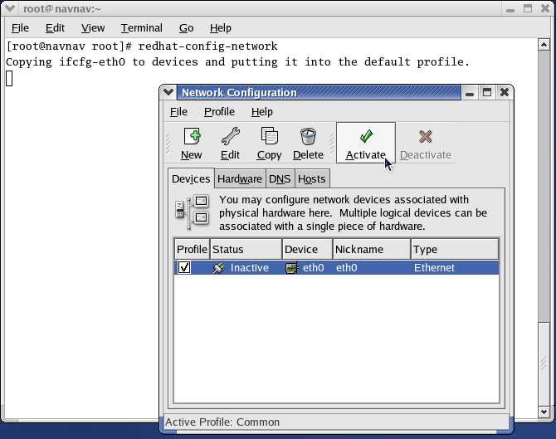
Go to terminal and type redhat-config-network. In network configuration manager, click on activate. If its already activated, then first click on deactivate and then click on activate.
With this internet has been connected. To check, go to browser and enter any web link.

Slide 21

Open browser and type URL

